Slide 1
Create Table with SQL Constraints
SQL constraints are used to specify rules for data in a table.
Constraints can be specified when the table is created with the CREATE TABLE statement, or after the table is created with the ALTER TABLE statement
Syntax
CREATE TABLE table_name ( column1 datatype constraint, column2 datatype constraint, column3 datatype constraint, .... );

Slide 2
SQL Constraints
NOT NULL - Ensures that a column cannot have a NULL value
UNIQUE - Ensures that all values in a column are different
PRIMARY KEY - A combination of a NOT NULL and UNIQUE. Uniquely identifies each row in a table
FOREIGN KEY - Uniquely identifies a row/record in another table
CHECK - Ensures that all values in a column satisfies a specific condition
DEFAULT - Sets a default value for a column when no value is specified
INDEX - Used to create and retrieve data from the database very quickly

Slide 3
NOT NULL Constraint
By default, a column can hold NULL values.
The NOT NULL constraint enforces a column to NOT accept NULL values.
This enforces a field to always contain a value, which means that you cannot insert a new record, or update a record without adding a value to this field.
Example
Create Table
CREATE TABLE Persons ( ID int NOT NULL UNIQUE, LastName varchar(255) NOT NULL, FirstName varchar(255), Age int );
Alter Table
ALTER TABLE Persons MODIFY Age int NOT NULL;

Slide 4
UNIQUE Constraint
The UNIQUE constraint ensures that all values in a column are different.
Both the UNIQUE and PRIMARY KEY constraints provide a guarantee for uniqueness for a column or set of columns.
A PRIMARY KEY constraint automatically has a UNIQUE constraint.
However, you can have many UNIQUE constraints per table, but only one PRIMARY KEY constraint per table.

Slide 5
UNIQUE Constraint
Create Table
SQL Server / Oracle / MS Access:
MySQL:
CREATE TABLE Persons ( ID int NOT NULL, LastName varchar(255) NOT NULL, FirstName varchar(255), Age int, UNIQUE (ID) );
CREATE TABLE Persons ( ID int NOT NULL UNIQUE, LastName varchar(255) NOT NULL, FirstName varchar(255), Age int );
UNIQUE Constraint On Multiple Columns
CREATE TABLE Persons ( ID int NOT NULL, LastName varchar(255) NOT NULL, FirstName varchar(255), Age int, CONSTRAINT UC_Person UNIQUE (ID,LastName) );

Slide 6
UNIQUE Constraint
Alter Table
MySQL/ SQL Server / Oracle / MS Access:
ALTER TABLE Persons ADD UNIQUE (ID);
UNIQUE Constraint On Multiple Columns
ALTER TABLE Persons ADD CONSTRAINT UC_Person UNIQUE (ID,LastName);

Slide 7
UNIQUE Constraint
DROP a UNIQUE Constraint
SQL Server / Oracle / MS Access:
MySQL:
ALTER TABLE Persons DROP CONSTRAINT UC_Person;
ALTER TABLE Persons DROP INDEX UC_Person;

Slide 8
PRIMARY KEY Constraint
The PRIMARY KEY constraint uniquely identifies each record in a table.
Primary keys must contain UNIQUE values, and cannot contain NULL values.
A table can have only ONE primary key; and in the table, this primary key can consist of single or multiple columns (fields).

Slide 9
PRIMARY KEY Constraint
Create Table
SQL Server / Oracle / MS Access:
MySQL:
CREATE TABLE Persons ( ID int NOT NULL, LastName varchar(255) NOT NULL, FirstName varchar(255), Age int, PRIMARY KEY (ID) );
CREATE TABLE Persons ( ID int NOT NULL PRIMARY KEY, LastName varchar(255) NOT NULL, FirstName varchar(255), Age int );
Constraint on multiple columns
CREATE TABLE Persons ( ID int NOT NULL, LastName varchar(255) NOT NULL, FirstName varchar(255), Age int, CONSTRAINT PK_Person PRIMARY KEY (ID,LastName) );

Slide 10
PRIMARY KEY Constraint
Alter Table
MySQL/ SQL Server / Oracle / MS Access:
ALTER TABLE Persons ADD PRIMARY KEY (ID);
UNIQUE Constraint On Multiple Columns
ALTER TABLE Persons ADD CONSTRAINT PK_Person PRIMARY KEY (ID,LastName);

Slide 11
PRIMARY KEY Constraint
DROP
SQL Server / Oracle / MS Access:
MySQL:
ALTER TABLE Persons DROP PRIMARY KEY;
ALTER TABLE Persons DROP CONSTRAINT PK_Person;;

Slide 12
FOREIGN KEY Constraint
A FOREIGN KEY is a key used to link two tables together.
A FOREIGN KEY is a field (or collection of fields) in one table that refers to the PRIMARY KEY in another table.
The table containing the foreign key is called the child table, and the table containing the candidate key is called the referenced or parent table.

Slide 13
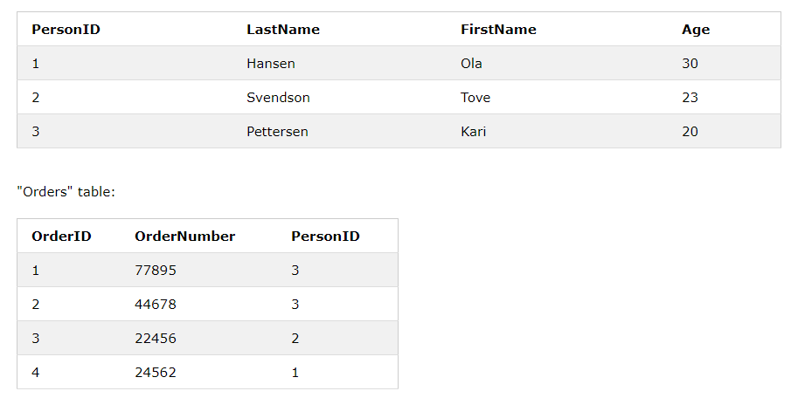
FOREIGN KEY Constraint

Slide 14
FOREIGN KEY Constraint
Create Table
MySQL:
CREATE TABLE Orders ( OrderID int NOT NULL, OrderNumber int NOT NULL, PersonID int, PRIMARY KEY (OrderID), FOREIGN KEY (PersonID) REFERENCES Persons(PersonID) );
SQL Server / Oracle / MS Access:
CREATE TABLE Orders ( OrderID int NOT NULL PRIMARY KEY, OrderNumber int NOT NULL, PersonID int FOREIGN KEY REFERENCES Persons(PersonID) );

Slide 15
FOREIGN KEY Constraint
Alter Table
MySQL/ SQL Server / Oracle / MS Access:
ALTER TABLE Orders ADD FOREIGN KEY (PersonID) REFERENCES Persons(PersonID);

Slide 16
FOREIGN KEY Constraint
DROP
SQL Server / Oracle / MS Access:
MySQL:
ALTER TABLE Orders DROP FOREIGN KEY FK_PersonOrder;
ALTER TABLE Orders DROP CONSTRAINT FK_PersonOrder;

Slide 17
CHECK Constraint
The CHECK constraint is used to limit the value range that can be placed in a column.
If you define a CHECK constraint on a single column it allows only certain values for this column.
If you define a CHECK constraint on a table it can limit the values in certain columns based on values in other columns in the row.

Slide 18
CHECK Constraint
Create Table
SQL Server / Oracle / MS Access:
MySQL:
CREATE TABLE Persons ( ID int NOT NULL, LastName varchar(255) NOT NULL, FirstName varchar(255), Age int, CHECK (Age>=18) );
CREATE TABLE Persons ( ID int NOT NULL, LastName varchar(255) NOT NULL, FirstName varchar(255), Age int CHECK (Age>=18) );
Constraint on multiple columns
CREATE TABLE Persons ( ID int NOT NULL, LastName varchar(255) NOT NULL, FirstName varchar(255), Age int, City varchar(255), CONSTRAINT CHK_Person CHECK (Age>=18 AND City='Sandnes') );

Slide 19
CHECK Constraint
Alter Table
MySQL/ SQL Server / Oracle / MS Access:
ALTER TABLE Persons ADD CHECK (Age>=18);
UNIQUE Constraint On Multiple Columns
ALTER TABLE Persons ADD CONSTRAINT CHK_PersonAge CHECK (Age>=18 AND City='Sandnes');

Slide 20
CHECK Constraint
DROP
SQL Server / Oracle / MS Access:
MySQL:
ALTER TABLE Persons DROP CHECK CHK_PersonAge;
ALTER TABLE Persons DROP CONSTRAINT CHK_PersonAge;

Slide 21
DEFAULT Constraint
DEFAULT constraint is used to provide a default value for a column.
The default value will be added to all new records IF no other value is specified.

Slide 22
DEFAULT Constraint
Create Table
MySql/SQL Server / Oracle / MS Access:
CREATE TABLE Persons ( ID int NOT NULL, LastName varchar(255) NOT NULL, FirstName varchar(255), Age int, City varchar(255) DEFAULT 'Sandnes' );
DEFAULT constraint can also be used to insert system values
CREATE TABLE Orders ( ID int NOT NULL, OrderNumber int NOT NULL, OrderDate date DEFAULT GETDATE() );

Slide 23
DEFAULT Constraint
Alter Table
MySQL:
Oracle:
ALTER TABLE Persons ALTER City SET DEFAULT 'Sandnes';
ALTER TABLE Persons MODIFY City DEFAULT 'Sandnes';
SQL Server:
MS Access:
ALTER TABLE Persons ADD CONSTRAINT df_City DEFAULT 'Sandnes' FOR City;
ALTER TABLE Persons ALTER COLUMN City SET DEFAULT 'Sandnes';

Slide 24
DEFAULT Constraint
DROP
SQL Server / Oracle / MS Access:
MySQL:
ALTER TABLE Persons ALTER City DROP DEFAULT;
ALTER TABLE Persons ALTER COLUMN City DROP DEFAULT;

Slide 25
AUTO INCREMENT Field
Auto-increment allows a unique number to be generated automatically when a new record is inserted into a table.
Often this is the primary key field that we would like to be created automatically every time a new record is inserted.

Slide 26
DEFAULT Constraint
Create Table
MySql/SQL Server / Oracle / MS Access:
CREATE TABLE Persons ( Personid int NOT NULL AUTO_INCREMENT, LastName varchar(255) NOT NULL, FirstName varchar(255), Age int, PRIMARY KEY (Personid) );

